Slide 1
DevOps
Development Operations

Slide 2
Software models
Introduction to SDLC
Code and Fix
Waterfall Model
Iterative Model
Agile Development Models
Lean Model

Slide 3
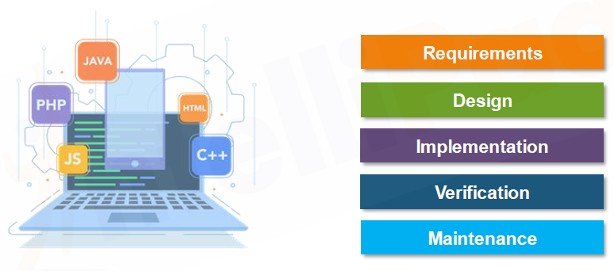
What is Software Development?
Converting customer requirement to complete software product.

Slide 4
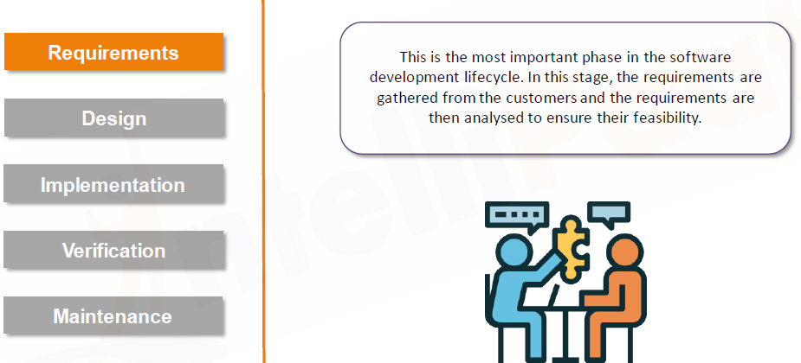
Software Development lifecycle

Slide 5
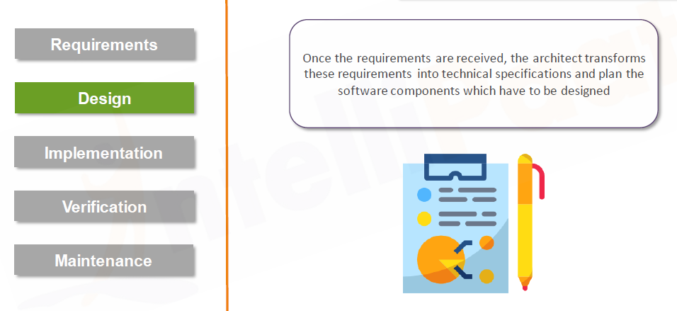
Software Development Life cycle

Slide 6
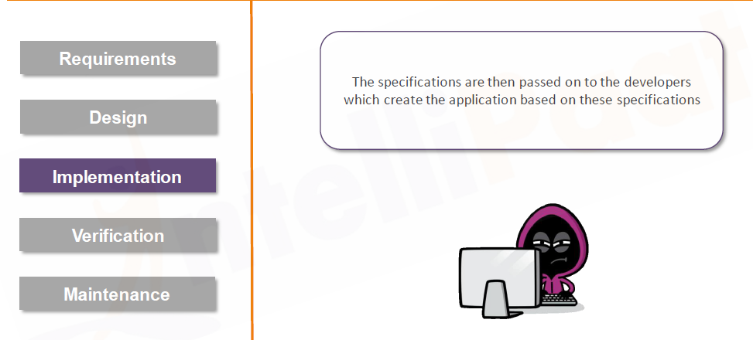
Software Development lifecycle

Slide 7
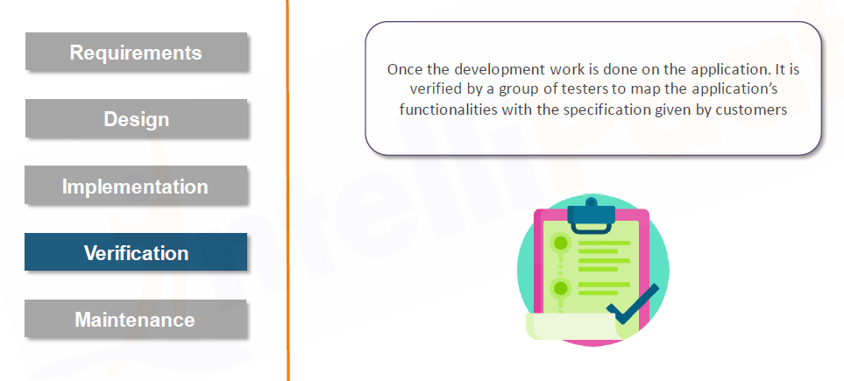
Software Development lifecycle

Slide 8
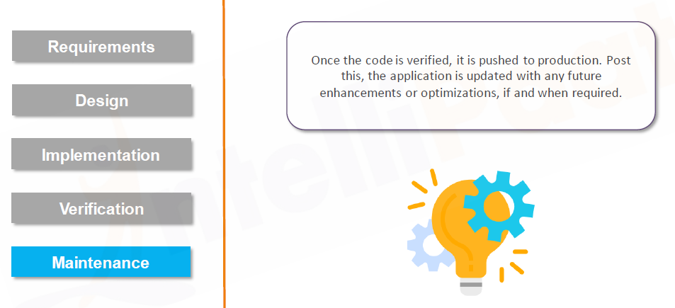
Software Development Life cycle

Slide 9
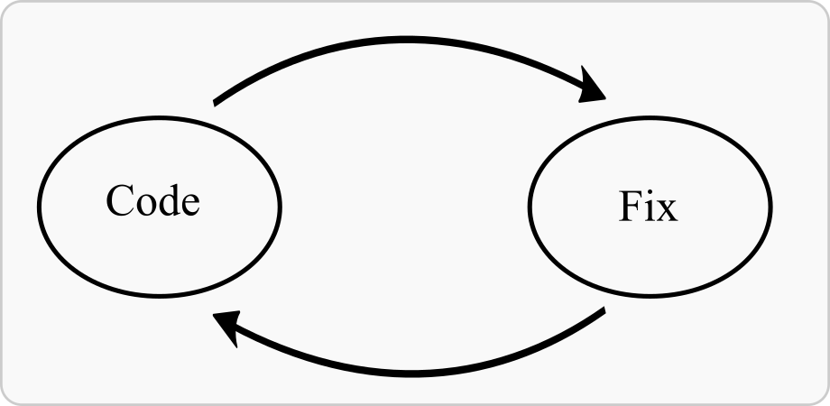
Code and Fix
Natural model of software development
Simple
Following steps are involved (recursively)
Write the code
Find a bug
Fix the bug
When to use Code and Fix?
Prototypes that don’t need any initial planning.
Small projects that won’t require any further development

Slide 10
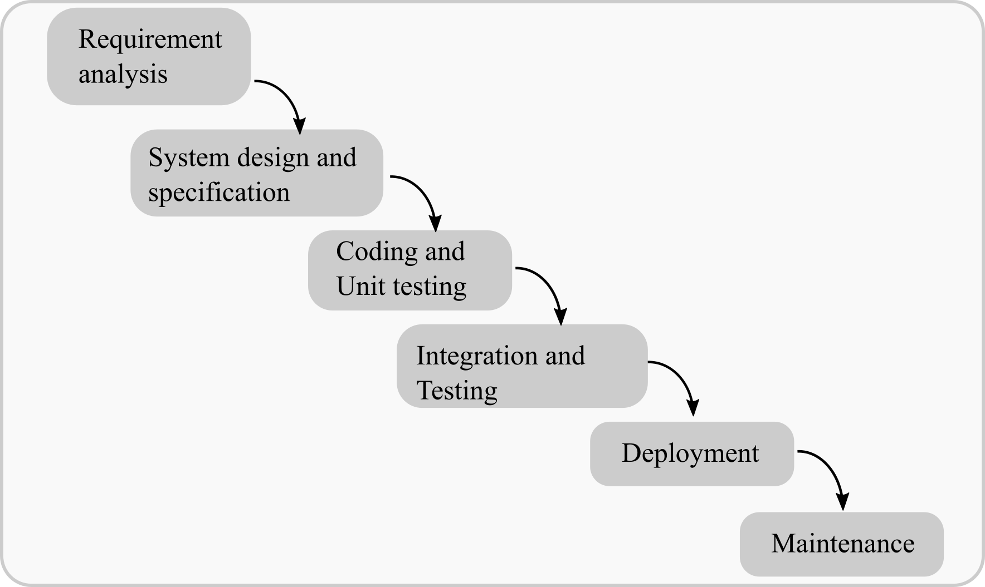
Waterfall Model

Slide 11
Waterfall model continues...
Requirement analysis
The aim of the requirement analysis and specification phase is to understand the exact requirements of the customer and document them properly.
System Design and Specification
The aim of the design phase is to transform the requirements specified in the SRS document into a structure that is suitable for implementation in some programming language.
Coding and Unit Testing
In coding phase software design is translated into source code using any suitable programming language. Thus each designed module is coded. The aim of the unit testing phase is to check whether each module is working properly or not.
Integration and Testing
All the units developed in the implementation phase are integrated into a system after testing of each unit. Post integration the entire system is tested for any faults and failures.
α-testing: α-testing is the system testing performed by the development team.
β-testing: β-testing is the system testing performed by a friendly set of customers.
Acceptance testing: After the software has been delivered, the customer performed the acceptance testing to determine whether to accept the delivered software or to reject it.

Slide 12
Waterfall model continues...
5. Deployment
Once the functional and non-functional testing is done; the product is deployed in the customer environment or released into the market.
6. Maintenance
Maintenance is the most important phase of a software life cycle. The effort spent on maintenance is the 60% of the total effort spent to develop a full software. There are basically three types of maintenance :
Corrective Maintenance: This type of maintenance is carried out to correct errors that were not discovered during the product development phase.
Perfective Maintenance: This type of maintenance is carried out to enhance the functionalities of the system based on the customer’s request.
Adaptive Maintenance: Adaptive maintenance is usually required for porting the software to work in a new environment such as work on a new computer platform or with a new operating system.

Slide 13
Waterfall Model Continues...
Advantages
This model is very simple and is easy to understand.
Phases in this model are processed one at a time.
Each stage in the model is clearly defined.
This model has very clear and well undestood milestones.
Process, actions and results are very well documented.
Reinforces good habits:
define-before- design,
design-before-code.
This model works well for smaller projects and projects where requirements are well understood.

Slide 14
Waterfall Model Continues...
Disadvantages
No Feedback Path.
Difficult to accomodate change requests.

Slide 15
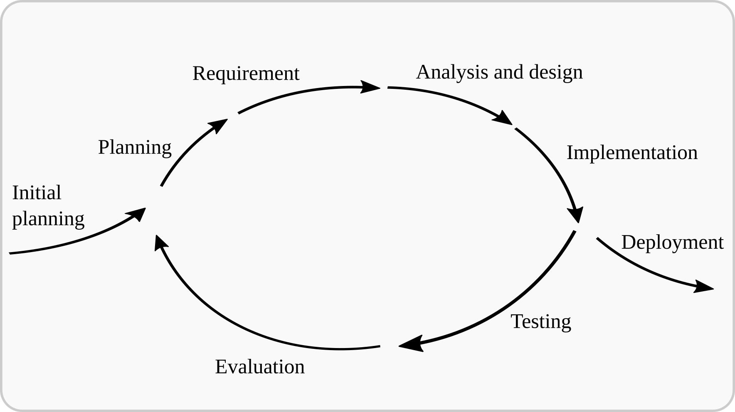
Iterative Model
Iterative process starts with a simple implementation of a subset of the software requirements and iteratively enhances the evolving versions until the full system is implemented.

Slide 16
Iterative Model Continues...
Applications
Requirements of the complete system are clearly defined and understood.
Major requirements must be defined; however, some functionalities or requested enhancements may evolve with time.
There is a time to the market constraint.
A new technology is being used and is being learnt by the development team while working on the project.
Resources with needed skill sets are not available and are planned to be used on contract basis for specific iterations.

Slide 17
Iterative Model Continues...
Advantages
Some working functionality can be developed quickly and early in the life cycle.
Results are obtained early and periodically.
Parallel development can be planned.
Progress can be measured.
Less costly to change the scope/requirements.
Testing and debugging during smaller iteration is easy.
Easier to manage risk - High risk part is done first.
With every increment, operational product is delivered.
Issues, challenges and risks identified from each increment can be utilized/applied to the next increment.
It supports changing requirements and Initial Operating time is less.
Better suited for large and mission-critical projects.
During the life cycle, software is produced early which facilitates customer evaluation and feedback.

Slide 18
Iterative Model Continues...
Limitations
More resources may be required.
Although cost of change is lesser, but it is not very suitable for changing requirements.
More management attention is required.
System architecture or design issues may arise because not all requirements are gathered in the beginning of the entire life cycle.
Defining increments may require definition of the complete system.
Not suitable for smaller projects.
Management complexity is more.
End of project may not be known which is a risk.
Highly skilled resources are required for risk analysis.
Projects progress is highly dependent upon the risk analysis phase.

Slide 19
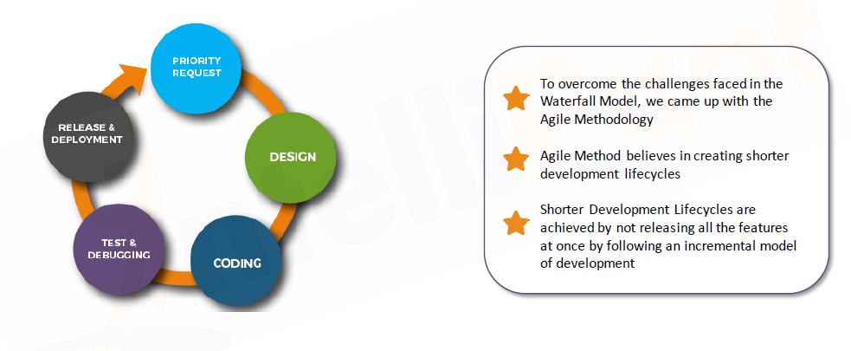
Agile Model

Slide 20
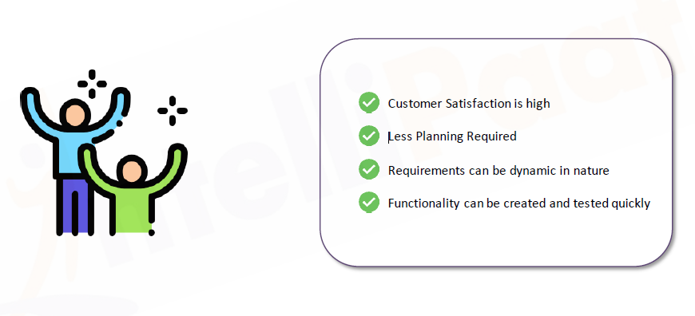
Advantage of Agile Model

Slide 21
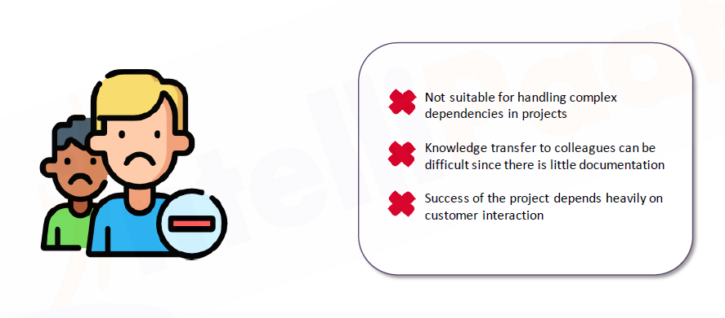
Disadvantage of Agile model

Slide 22
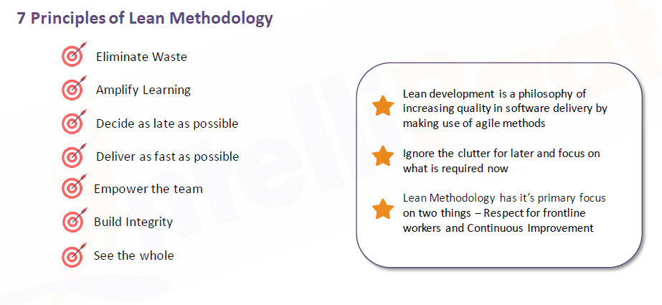
Lean Model

Slide 23
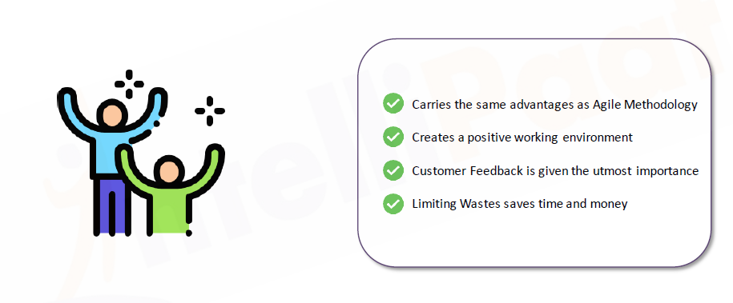
Advantage of Lean Model

Slide 24
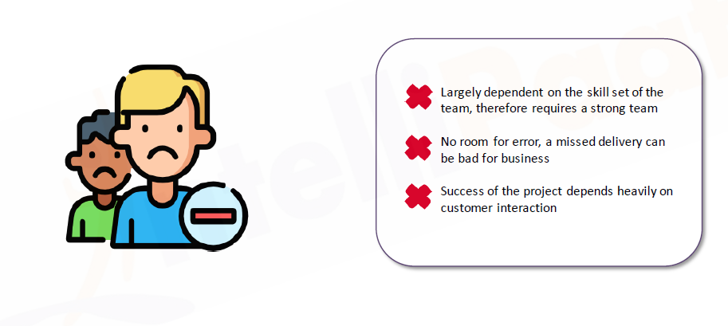
Disadvantage of Lean model

